Slide 1


Slide 2
OFFER – Equity in AWE (Pty) ltd
The company has issued 8,000,000 million shares to its founders and executives.
10 million Shares are being offered at .50c per share;
A total of 50 million shares will be authorised and 30,000,000 will be in issue;
+-R1,500,000 set up costs that will be paid out of the proceeds of this offer; the balance will be used to set up investment strategy and execution;
The company will have no further setup costs;
12,000,000 shares are held iro Holding Company which is currently being established in Mauritius.
Legal representation is Deon Perold, DP Law, based in Kenilworth, Cape Town
Auditors are being interviewed and to be appointed

Slide 3
Shareholding
AWE Pty Ltd
Shareholding |  | % | Rand Value | Per Share | No Shares
Jacqueline Zwambila | Chair. Non exec director Foundation | 5,00% | 750 000,00 |  | 1 500 000,00
Nicole Petyt | CEO | 5,00% | 750 000,00 |  | 1 500 000,00
Riane Zieske | Dir Non-Exec Foundation | 3,33% | 500 000,00 |  | 1 000 000,00
Heidi Kincaid | CFO | 5,00% | 750 000,00 |  | 1 500 000,00
O'Reilly Foundation Trust | Bus Dev/ Commercial Contracts | 8,33% | 1 250 000,00 |  | 2 500 000,00
Investors | Working Capital | 33,33% | 5 000 000,00 | 0,50 | 10 000 000,00
to be registered | Holding company | 40,00% | 6 000 000,00 |  | 12 000 000,00
 |  | 100,00% | 15 000 000,00 | 0,50 | 30 000 000,00
 | No Shares Authorised |  | 50 000 000,00
 | No Shares Issued |  | 30 000 000,00

Slide 4
Corporate Structure
African Harvest (Mauritius) (Investor funding manager)
INVESTMENTS IN POWER/ WATER/ AGRIC/ ECD/ BUILD TECH
FUND/ ASSET MANAGER
(3rd party manger under mandate)
(Mauritius)
The AWE Foundation – public benefit projects
AWE - operations

Slide 5
Our Corporate Structure
Africa Women Enterprises (Pty) Ltd t/a AWE (Pty) Ltd
The AWE Foundation
ECD/ Learning management systems/Adult Ed.
Sustainable Agri-Tech
Public Benefit/ Social Upliftment / Water Tech/ Power Tech/ Build Tech
African Harvest (Mauritius)
Entrepreneur/ Start up Development

Slide 6
Investments
AWE (Pty) LTD
AWE Foundation
POWER – Gasifier/ Wind/ Solar (TBC)
WATER –Aqua4life (20%)
BUILD –
3D PrintCrete (33,33%)

Slide 7
Our Corporate Structure
Company Roles
AWE (Mauritius)
- Management Company with AFRICA focus
- Raising investment/grant/ donation funds
- Managing funds with 3rd party fund manager under mandate
- Provide funds via AWE Pty Ltd for Africa for
- Investments in Technologies
- Investment in viable businesses start-ups
- Investment in SMMEs for support of “graduates”
- Investment in sustainable agric. business
- Provide small scale start ups funding for qualifying “graduates” based on forecasts and repayment plans
AWE (Pty) Ltd
- Raising shareholder capital for WC
- The AWE Foundation – Identify business tech opportunities for investment
- Perform Due Diligences on investments
- Manage investments for best ROI
- Fiscal Management of roll out of projects
The AWE Foundation (AFRICA)
- Social/Empowerment/ Education/ ECD
- Identify prospective projects and communities
- Manage projects identified and authorised
- Ensure effective usage of tech and skills transfer

Slide 8
Our Corporate Structure… Directors
AWE (Pty) Ltd
CEO – Nicole Petyt MBA
CFO – Heidi Kincaid CA SA
The AWE Foundation
Chair (Non Exec) – Ambassador Jacquie Zwambila
CEO – Nicole Petyt MBA
CFO – Heidi Kincaid CA SA
Non Exec Dir. – Kabira Akoob (fundraiser) MBL UNISA
Non Exec Dir. – Riane Ziesecke (fundraiser)

Slide 9
Use of Funds
  There are technologies, SMMEs and systems that will be utilised under the umbrella of AWE to generate profit for good and returns for investors. Those identified are:
The Gasifier- power/ heat(cooling) from processing waste (Commercial sales)
Agri-Tech-sustainable farming/ hydroponic development ( Produce for commercial Sales)
Edu-Tech Education Programmes- ECD support / Adult literacy (Advertising sponsorship/ curriculum module licensing fees)
Edu-Tech Online - for artisans (TVT) (Advertising sponsorship/ curriculum module licensing fees)
Water-Tech - Aquanaut- solar/ wind powered water distillation with regeneration IP for clean healthy drinking water – (Commercial sales)
Build –Tech – 3d PrintCrete – 3d Concrete Printer Technology –A FIRST FOR AFRICA (Public Private, contract, Commercial sales)
Pop up Spectacle Dispensary/ Mobile business development – providing low cost solutions for spectacles/ computer repairs/ “spaza” shops/ mobile auto repairs & maintenance etc. (Commercial Sales)
Blood Sisters – exclusive professional crime scene clean-up. ( Service fees)
Mobile Vehicle Mechanics – Franchisable concept.
ROI on investment into these techs/ business units should start yielding within 18 to 24 months as they are ready to go to manufacture/ launch.

Slide 10
What will the Specific Technology do?
The Gasifier uses ALL waste/ garbage to burn and create steam and various gases that create energy that can be used to take farms, especially dairy farms, business parks, residential complexes and eventually private homes off the national electricity grid. Excess can/ may be fed back into grid.
Through Water Tech, we can provide +-20,000L pd of clean healthy drinking water from ANY feed water source using solar/ wind. If we instead use power from a gasifier which will give significantly more power for longer, we can increase this output +-10 fold.
Build Tech – Sa’s 1st 3D concrete printing technology. The ability to print a small house in 24 hours. With a backlog of some 2,1m houses for the poorest of our communities who live in undignified, ramshackle shanties often more than 5 in a single room without any basic services. Integration with our other tech could provide turnkey solutions. Applications include rural clinics and schools etc
Through Agri-Tech, we invest in and teach women to plant the best crops for their area, the gold-standard methods without the costs, and the best places to sell their crops. This will grow smallholdings into farm lands that are profitable, using expert mentoring

Slide 11
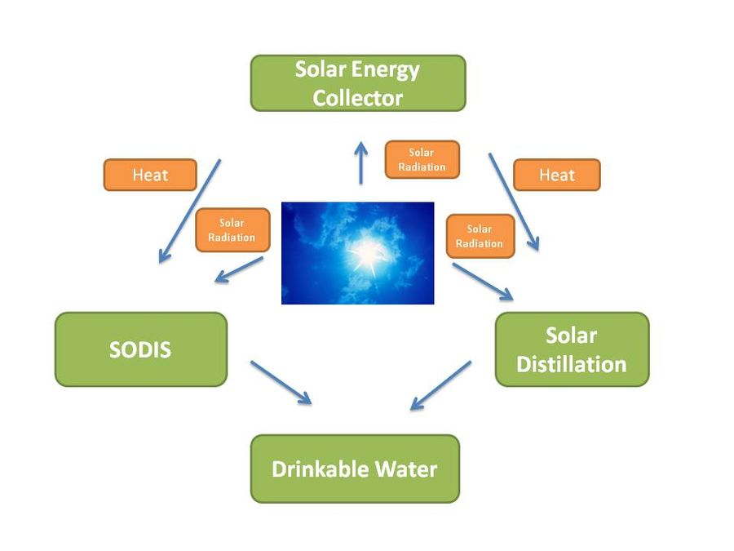
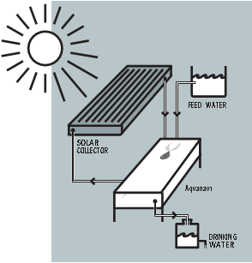

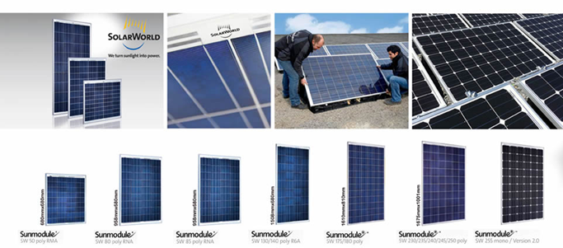
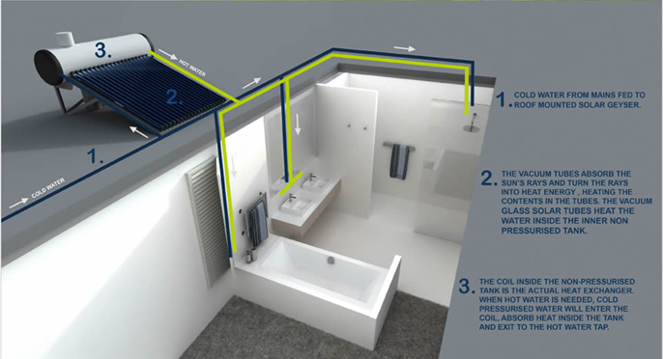
CONCEPT – Aquanaut (ready for Prototype)

Slide 12
Aquanaut - Device and technology advantages
Re-use of energy through numerous evaporation/convection stages
• Complete separation of feed and distilled water – no cross-over
• No moving parts
• All water movement is by gravity and one way – alternate can be implemented.
• Unique dosing unit for every stage
• Fool-proof design for easy re-siting
• State of the art materials and IP technologies
• Can be stacked horizontally with multiple units occupying very little area
• Tolerates UV, heat, windy and harsh environments
• Device materials with life time of 15 to 20+ years (feed water quality dependent).

Slide 13
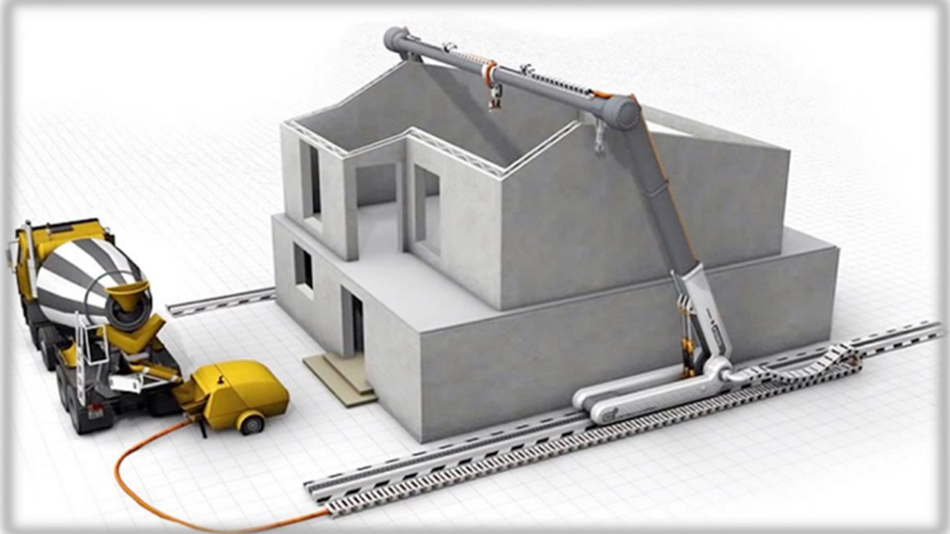
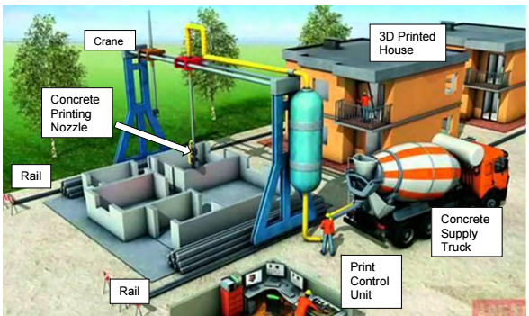
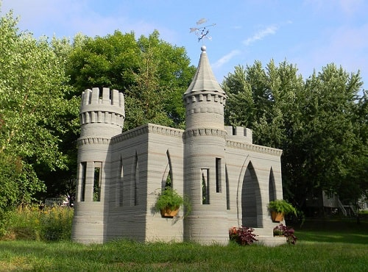
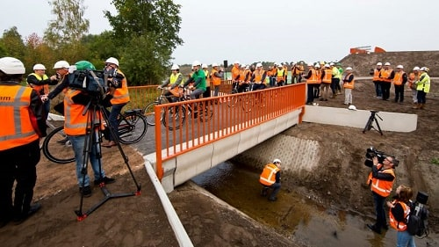
Prototype - ConCrete Printer

Slide 14
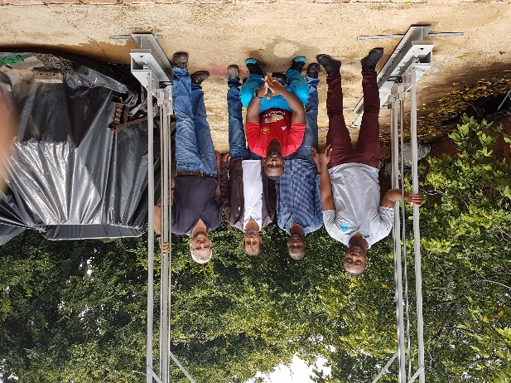
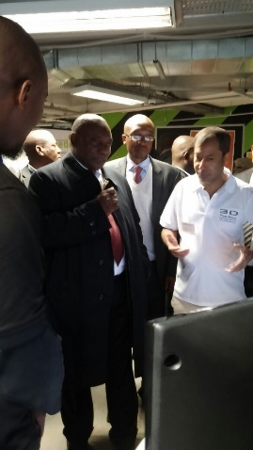
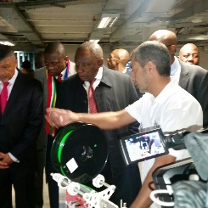
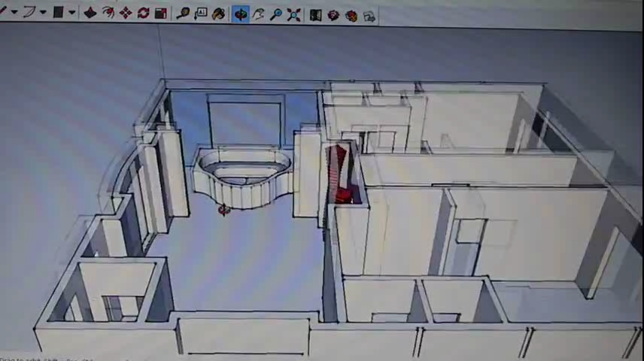
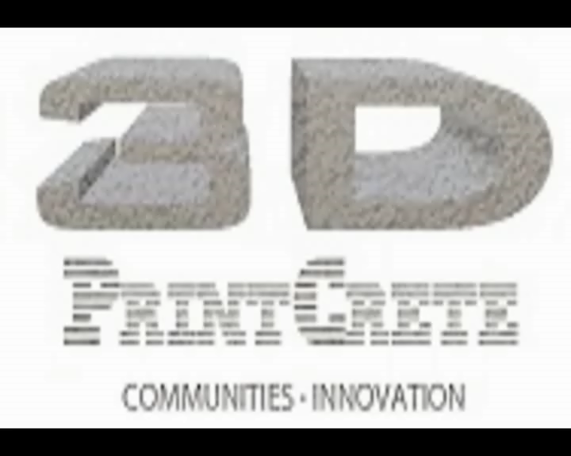
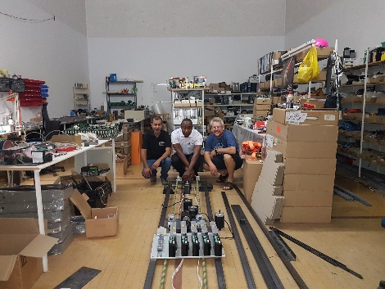
Gallery

Slide 15
3D PrintCrete – device and Technology advantages
3D PrintCrete is an innovative construction technology company that specializes in 3D concrete printing technology. Founded in 2014, 3D PrintCrete is in the process of developing Africa’s first 3D concrete printer with the vision of one day fully automating construction.
Printing at an architectural scale is difficult, but 3D concrete printers have some real game-changing benefits. Here are the major advantages of this technology:
3D printers are fast, they can print continuously. We see that some companies are now able to build entire houses in 24 hours.
The manufacturing process is economical, you only use the printing material that you need for your 3D construction. Moreover you have no labour costs.
3D printers are allowing construction of houses anywhere at an affordable price. It could be idealto create houses for poor populations using 3D printing, for instance
3D printed structures are strong, some buildings are made to resist tornados. It is totally possible to create strong foundations for your 3D houses.
Design possibilities are endless if you use a 3D printer. It is true for all sectors, and construction is not an exception. You can give life to incredible designs with concrete 3D printers thanks to this freeform construction method
All of these advantages are real, and as the technology is improving, these benefits will be even more numerous.
Other advantages include
1. Reduce costs e.g. labour
2. Reduce construction time
3. High architectural flexibility.
4. Manufacturing (Industrialisation)
Materials used will be made up of various composite mediums depending on build requirements.

Slide 16
Technology Impact around the world
The impact of technology on construction is growing. Consider:
  the change clustering around the related areas of advanced software
  BIM (Building Information Modelling)
  Digitalisation
  Add in the IoT and Smart Technology
  Plus some 3D printing
  and you complete the top five technologies having an impact on the construction sector.
  The results suggest service providers and real estate developers appear to be seeing the impact of these particular technologies the most, while contractors were most acutely alert to the impact of advanced software.
  The Voice Of The Construction Industry Report surveyed 5,951 senior construction industry professionals, based in 136 different countries, and analyses their responses by specific construction sector, market, company size and seniority.
  https://1drv.ms/b/s!AoOuZGs9eV2IkSDL8rYHhqfacZWT?e=Eqh44b

Slide 17


